Slide 1
RTF DOA estimators

Slide 2
Assumptions
The locators are primarily formulated for single source problems.
For multi-source scenarios, the “personalized” RTF estimates of each source must be available.

Slide 3
Modified SPS

Slide 4
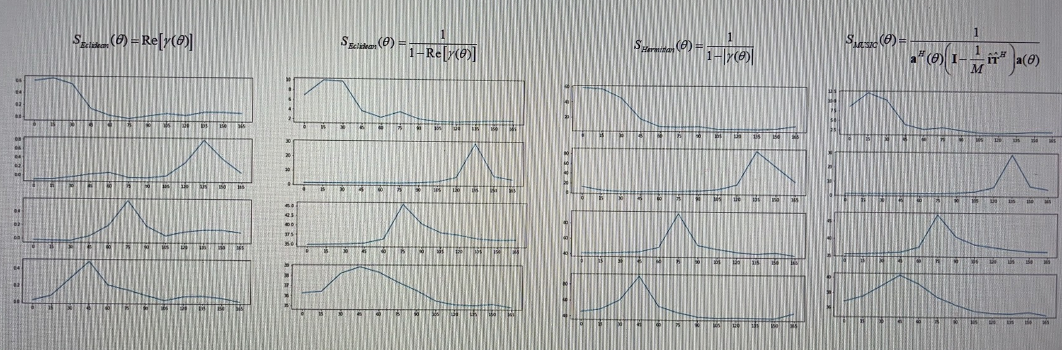
Results

Slide 5
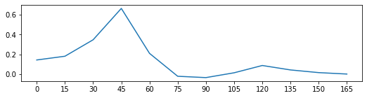
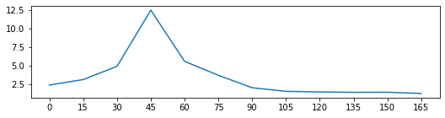
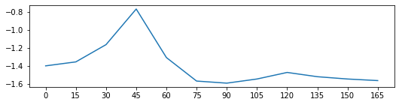
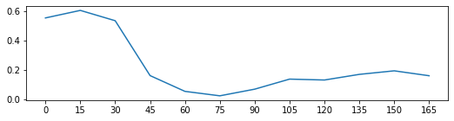
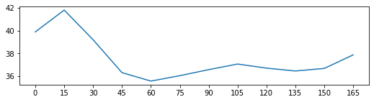
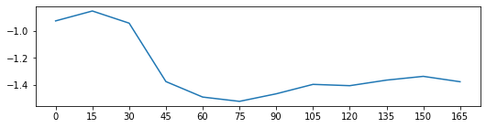
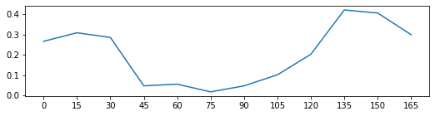
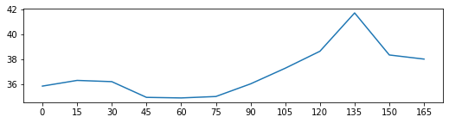
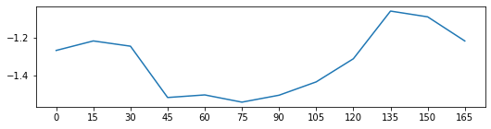
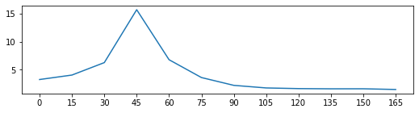
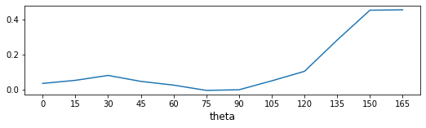
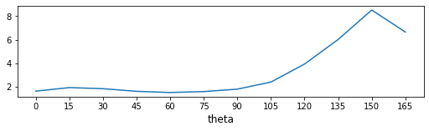
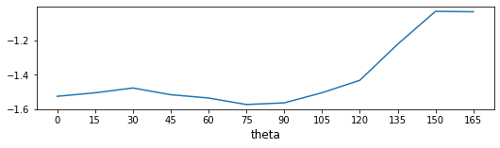
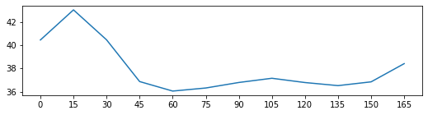
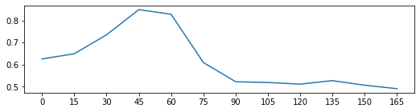
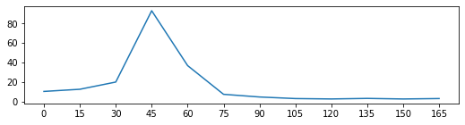
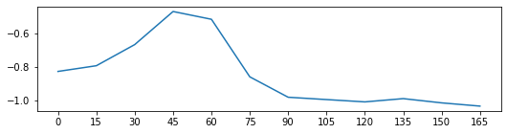
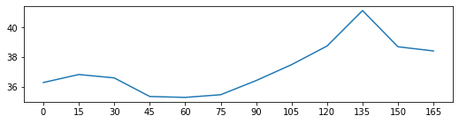
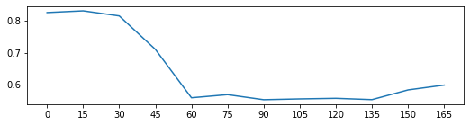
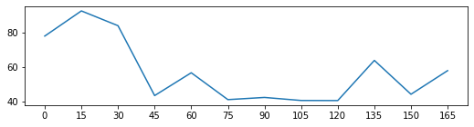
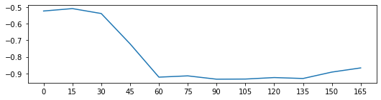
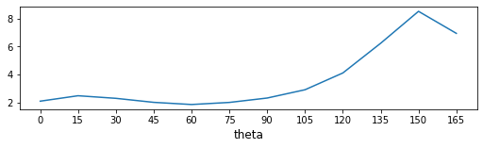
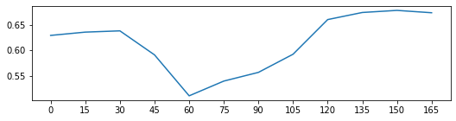
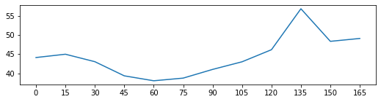
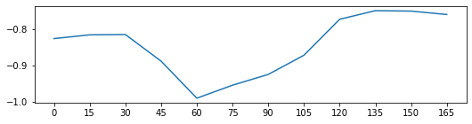
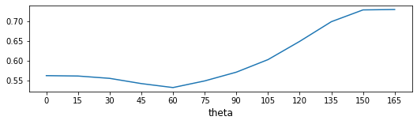
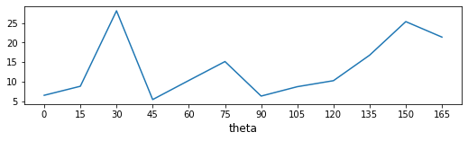
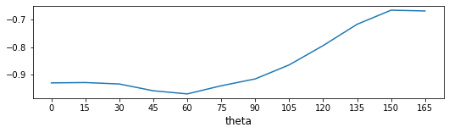
Ground truth position

Slide 6
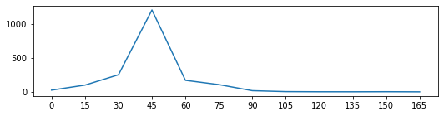
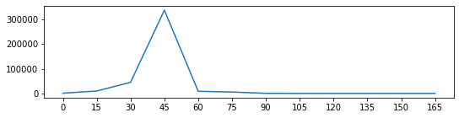
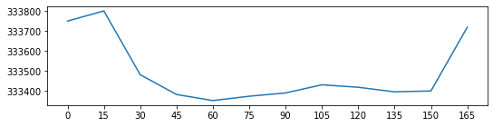
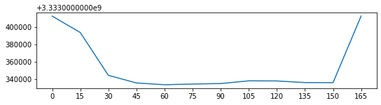
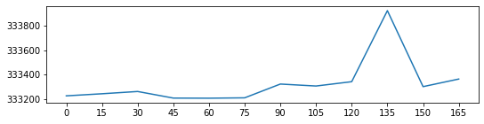
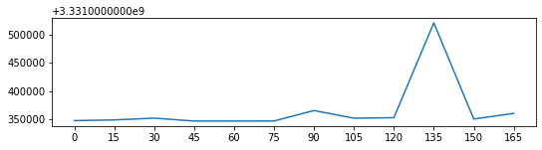
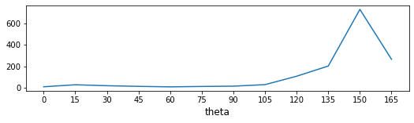
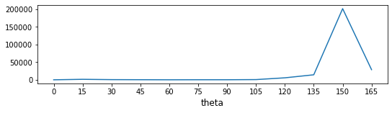

Slide 7
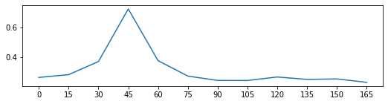
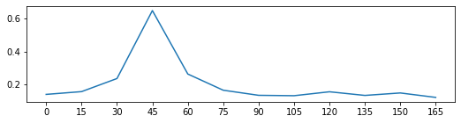
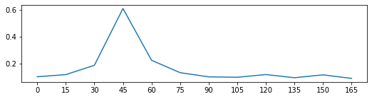
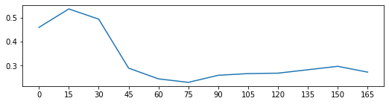
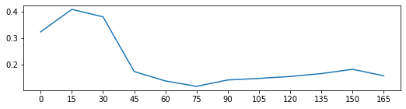
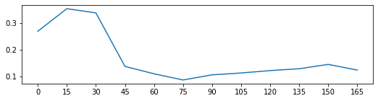
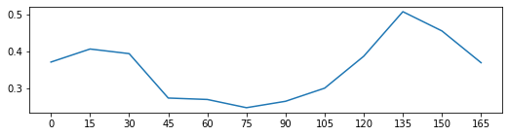
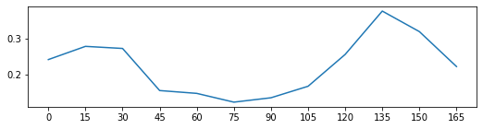
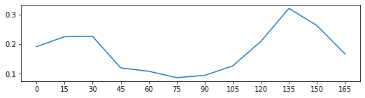
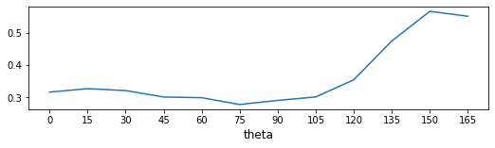
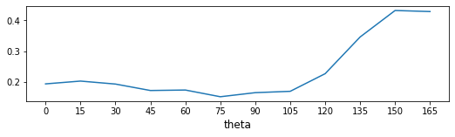
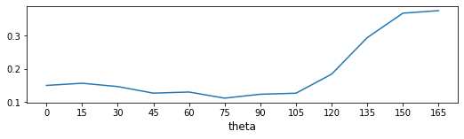
Normalized RTF locators
→ Frequency selection to isolate the source-dominated TF bins should help improve the results.

Slide 8
Remarks
The novelty of the above approaches is that the localization algorithm is based on RTF estimates, which is rarely seen in the literature.
RTF estimates are often the by-product of separation problems.
It is worth exploring the above localizers in a more comprehensive simulation with different settings and scenarios in the future.

Slide 9

Reminder
EE yr2 proposal
NSTC proposal

Slide 10
More about localization
SPS construction: MUSIC, SRP, RTF/Hermitian angle → p.2 approaches
Frequency subset selection: GMSC, CDR1, CDR2 →p.19, Telepresence
Frequency fusion mechanisms: narrowband (histogram), broadband (summation), speaker grouping (with separation?)
With and without separation
Binaural ITD-based speaker-grouped frequency grouping
Potential extensions: separation preprocessing, extended RTF-based approaches, new frequency subset selection, DNN, ranging prob
Refs
Binaural DOA_RTF_Doclo.pdf
binaural DOA_Gannot.pdf

Slide 11
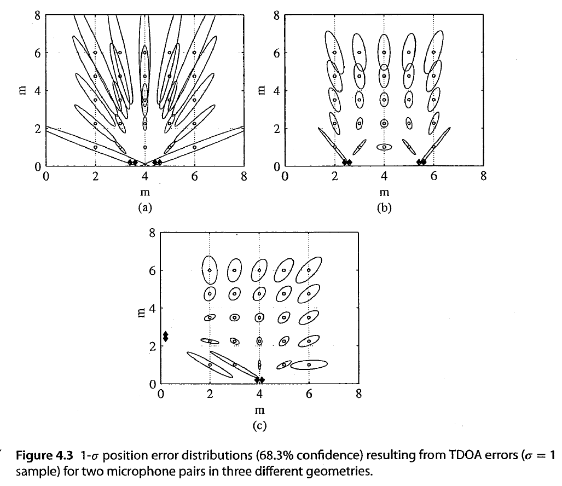
Effect of array geometry on the localization error -- p.57, Vincent et al. book

Slide 12
Proposed ranging technique
Design a sub-array and designate the array center as the coordinate origin?
Estimate DOA using SRP-PHAT, MUSIC, based on the plane-wave model
Estimate RTF using measured pressure dada
Compare the measured RTF and the freefield monopole-based steering vector.
Fine-search the distance based on the following RTF-based spatial feature:

Slide 13
If everything fails,…
Use a distributed array
Use the MUSIC or TDOA algorithms based on the point-source model

Slide 14
TDOA setup for distributed array
→ Need to estimate TDOA using GCC-PHAT

Slide 16
→see TOA_TDOA/TDOA noise covariance matrix.ppt

